Slide 1
collision of robotic bees
Camila Barona cabrera
Mariana Gómez Piedrahita

Slide 2
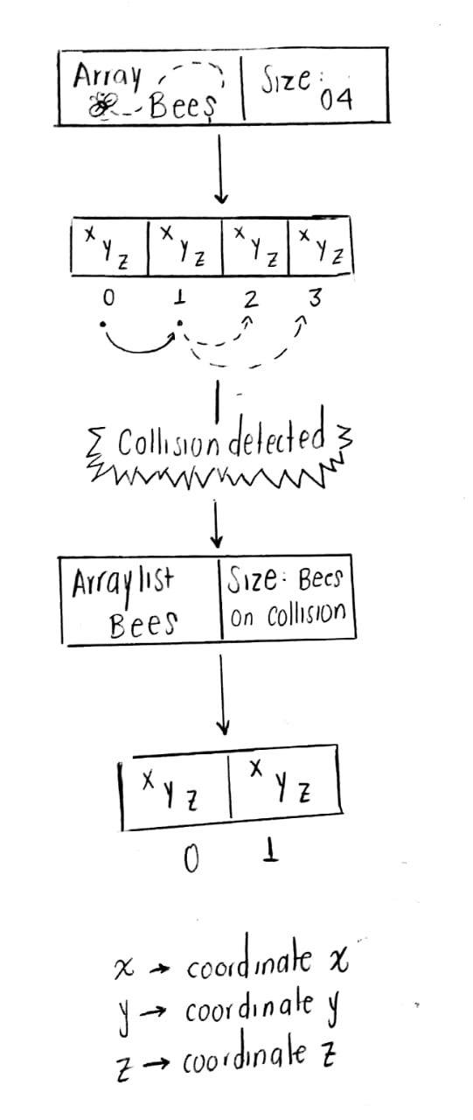
data structure
Arrays
ArraysList

Slide 3
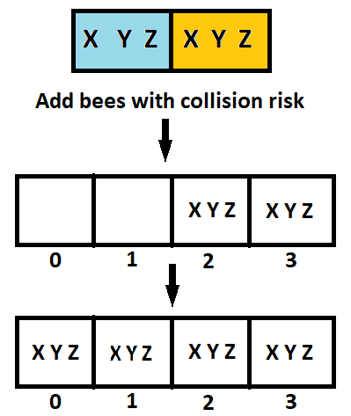
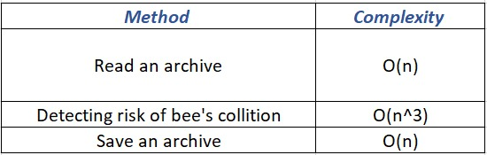
Operations and complexity

Slide 4
good data structure
In the beginning, the array is implemented, since the number of elements are defined. First of all, the set of bees that are at risk of collision are started, they are entered in an Array List, since the size of an array cannot be modified.
It is also clear that the number of bees that are going to collide is not defined, so there is no specific number to create the Array, in this way, they avoid wasting spaces inside the Array, since the total number of bees (those entered at the beginning) is not the same as that of collided bees; thus the use of the memory space is reduced and the travel time of the Array List is much smaller with the number of data required.
less memory storage
better execution time

Slide 5

Execution time memory consumption

